Slide 1
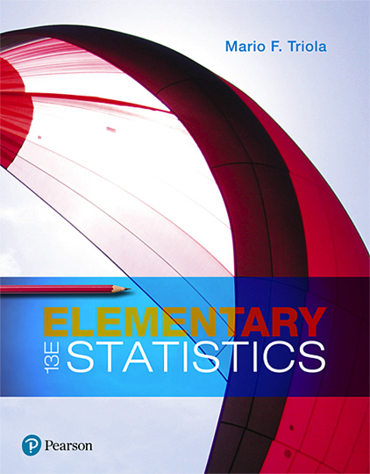
Elementary Statistics
Thirteenth Edition
Chapter 9
Inferences from Two Samples
Copyright © 2018, 2014, 2012 Pearson Education, Inc. All Rights Reserved

Slide 2
Inferences from Two Samples
9-1 Two Proportions
9-2 Two Means: Independent Samples
9-3 Two Dependent Samples (Matched Pairs)
9-4 Two Variances or Standard Deviations

Slide 3
Key Concept
This section presents methods for testing hypotheses and constructing confidence intervals involving the mean of the differences of the values from two populations that are dependent in the sense that the data consist of matched pairs. The pairs must be matched according to some relationship, such as before/after measurements from the same subjects or IQ scores of husbands and wives.

Slide 4
Good Experimental Design
When designing an experiment or planning an observational study, using dependent samples with matched pairs is generally better than using two independent samples.

Slide 5
Inferences About Differences from Matched Pairs: Objectives
​​Hypothesis Test: Use the differences from two dependent samples (matched pairs) to test a claim about the mean of the population of all such differences.
​​​​Confidence Interval: Use the differences from two dependent samples (matched pairs) to construct a confidence interval estimate of the mean of the population of all such differences.

Slide 6

Inferences About Differences from Matched Pairs: Notation for Dependent Samples
d = individual difference between the two values in a single matched pair
µ_{d} = mean value of the differences d for the population of all matched pairs of data
s_{d} = standard deviation of the differences d for the paired sample data
n = number of pairs of sample data

Slide 7
Inferences About Differences from Matched Pairs: Requirements
The sample data are dependent (matched pairs).
The matched pairs are a simple random sample.
Either or both of these conditions are satisfied: The number of pairs of sample data is large (n > 30) or the pairs of values have differences that are from a population having a distribution that is approximately normal. These methods are robust against departures for normality, so the normality requirement is loose.

Slide 8
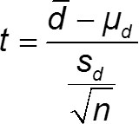
Inferences About Differences from Matched Pairs: Test Statistic for Dependent Samples (with H₀: µ_{d} = 0) (1 of 2)
P-Values: P-values are automatically provided by technology or the t distribution in Table A-3 can be used.

Slide 9
Inferences About Differences from Matched Pairs: Test Statistic for Dependent Samples (with H₀: µ_{d} = 0) (2 of 2)
Critical Values: Use Table A-3 (t distribution). For degrees of freedom, use df = n − 1.

Slide 10
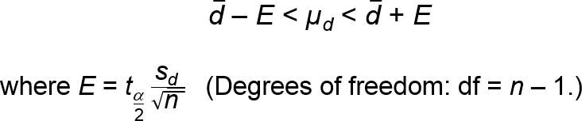
Inferences About Differences from Matched Pairs: Confidence Intervals for Dependent Samples

Slide 11
Procedures for Inferences with Dependent Samples
Verify that the sample data consist of dependent samples (or matched pairs), and verify that the requirements in the preceding slides are satisfied.
Find the difference d for each pair of sample values.
For hypothesis tests and confidence intervals, use the same t test procedures used for a single population mean.

Slide 12
Equivalent Methods
Because the hypothesis test and confidence interval in this section use the same distribution and standard error, they are equivalent in the sense that they result in the same conclusions. Consequently, a null hypothesis that the mean difference equals 0 can be tested by determining whether the confidence interval includes 0.

Slide 13
Example: Are Best Actresses Generally Younger Than Best Actors? (1 of 9)
Data lists ages of actresses when they won Oscars in the category of Best Actress, along with the ages of actors when they won Oscars in the category of Best Actor. The ages are matched according to the year that the awards were presented. This is a small random selection of the available data so that we can better illustrate the procedures of this section. Use the sample data with a 0.05 significance level to test the claim that for the population of ages of Best Actresses and Best Actors, the differences have a mean less than 0.
Actress (years) | 28 | 28 | 31 | 29 | 35
Actor (years) | 62 | 37 | 36 | 38 | 29
Difference d | −34 | −9 | −5 | −9 | 6

Slide 14
Example: Are Best Actresses Generally Younger Than Best Actors? (2 of 9)
Solution
Requirement Check (1) The samples are dependent because the values are matched by the year in which the awards were given. (2) The pairs of data are randomly selected. We will consider the data to be a simple random sample. (3) Because the number of pairs of data is n = 5, which is not large, we should check for normality of the differences and we should check for outliers. There are no outliers, and a normal quantile plot would show that the points approximate a straight-line pattern with no other pattern.
All requirements are satisfied.

Slide 15
Example: Are Best Actresses Generally Younger Than Best Actors? (3 of 9)
Solution
Step 1: The claim that the differences have a mean less than 0 can be expressed as µ_{d} < 0 year.
Step 2: If the original claim is not true, we have µ_{d} ≥ 0 year.
Step 3: The null hypothesis must express equality and the alternative hypothesis cannot include equality, so we have
H₀: µ_{d} = 0 year H₁: µ_{d} < 0 year (original claim)

Slide 16
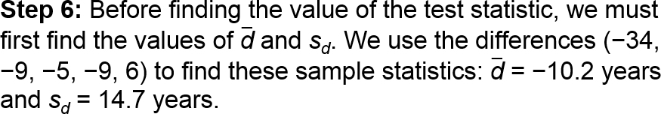
Example: Are Best Actresses Generally Younger Than Best Actors? (4 of 9)
Solution
Step 4: The significance level is α = 0.05.
Step 5: We use the Student t distribution.

Slide 17
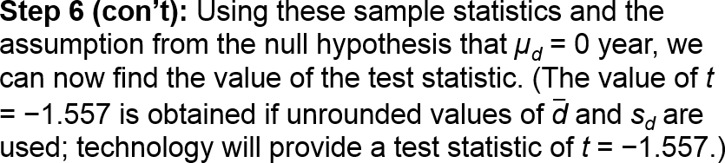
Example: Are Best Actresses Generally Younger Than Best Actors? (5 of 9)
Solution

Slide 18
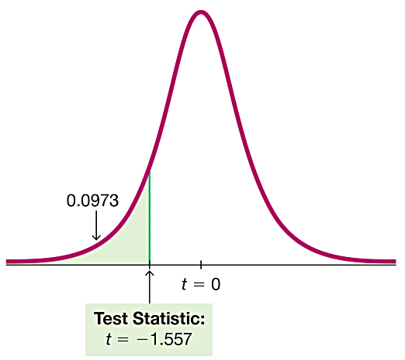
Example: Are Best Actresses Generally Younger Than Best Actors? (6 of 9)
Solution
P-Value Method Because we are using a t distribution, we refer to Table A-3 for the row with df = 4 and we see that the test statistic t = −1.552 corresponds to an “Area in One Tail” that is greater than 0.05, so P-value > 0.05. Technology would provide P-value = 0.0973.

Slide 19
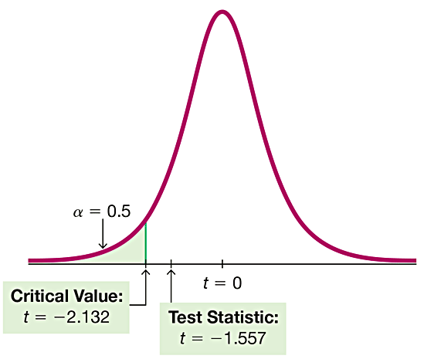
Example: Are Best Actresses Generally Younger Than Best Actors? (7 of 9)
Solution
Critical Value Method Refer to Table A-3 to find the critical value of t = −2.132 as follows: Use the column for 0.05 (Area in One Tail), and use the row with degrees of freedom of n − 1 = 4. The critical value t = −2.132 is negative because this test is left-tailed where all values of t are negative.

Slide 20
Example: Are Best Actresses Generally Younger Than Best Actors? (8 of 9)
Solution
Step 7: If we use the P-value method, we fail to reject H₀ because the P-value is greater than the significance level of 0.05. If we use the critical value method, we fail to reject H₀ because the test statistic does not fall in the critical region.

Slide 21
Example: Are Best Actresses Generally Younger Than Best Actors? (9 of 9)
Interpretation
We conclude that there is not sufficient evidence to support µ_{d} < 0. There is not sufficient evidence to support the claim that for the population of ages of Best Actresses and Best Actors, the differences have a mean less than 0. There is not sufficient evidence to conclude that Best Actresses are generally younger than Best Actors.

Slide 22
Example: Confidence Interval for Estimating the Mean of the Age Differences (1 of 4)
Using the same sample data, construct a 90% confidence interval estimate of µ_{d}, which is the mean of the age differences. By using a confidence level of 90%, we get a result that could be used for the previous hypothesis test. (Because the hypothesis test is one-tailed with a significance level of α = 0.05, the confidence level should be 90%.)

Slide 23
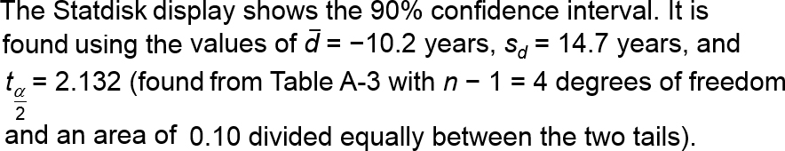
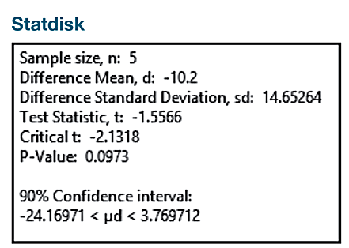
Example: Confidence Interval for Estimating the Mean of the Age Differences (2 of 4)
Solution
REQUIREMENT CHECK The solution for previous example includes verification that the requirements are satisfied.

Slide 24

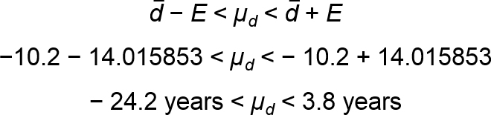
Example: Confidence Interval for Estimating the Mean of the Age Differences (3 of 4)
Solution
We first find the value of the margin of error E.
We now find the confidence interval.

Slide 25
Example: Confidence Interval for Estimating the Mean of the Age Differences (4 of 4)
Interpretation
We have 90% confidence that the limits of −24.2 years and 3.8 years contain the true value of the mean of the age differences. In the long run, 90% of such samples will lead to confidence interval limits that actually do contain the true population mean of the differences. The confidence interval includes the value of 0 year, so it is possible that the mean of the differences is equal to 0 year, indicating that there is no significant difference between ages of Best Actresses and Best Actors.

